Slide 1
Connectives
Imperatives- Instructions
Basic sentence structures

Slide 2
Moods
In grammar, mood is used to refer to a verb category or form which indicates whether the verb expresses a fact (the indicative mood), a command (the imperative mood), a question (the interrogative mood), a condition (the conditional mood), or a wish or possibility (the subjunctive mood).

Slide 3
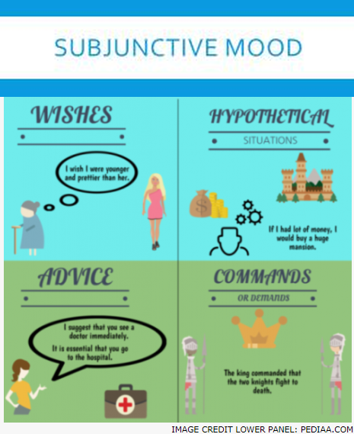

Slide 4
These moods are: indicative, imperative, interrogative, conditional and subjunctive.
Indicative. Indicative indicates a state of factuality or states something that is happening in reality. ...
Imperative. Imperative is a command. ...
Interrogative. Interrogative asks a question. ...
Conditional. ...
Subjunctive.

Slide 5
Subjunctive Mood. A verb is in the subjunctive mood when it expresses a condition which is doubtful or not factual. It is most often found in a clause beginning with the word “if”. It is also found in clauses following a verb that expresses a doubt, a wish, regret, request, demand, or proposal.

Slide 6
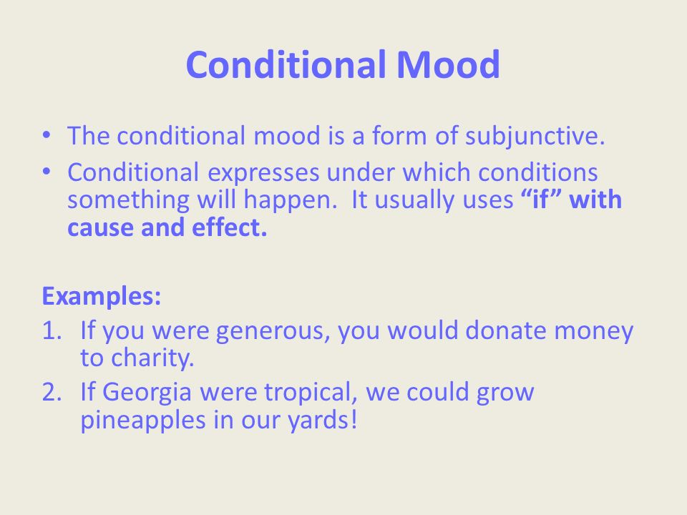

Slide 7
Verbs?

Slide 8
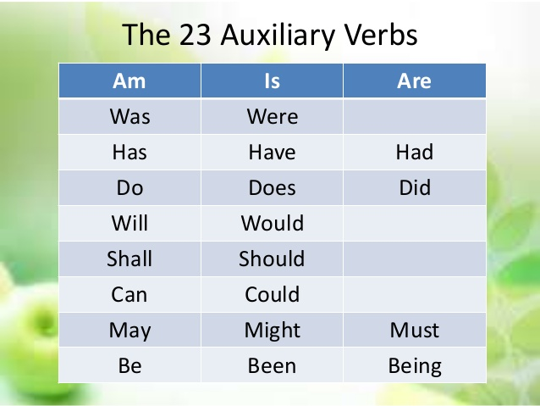

Slide 9
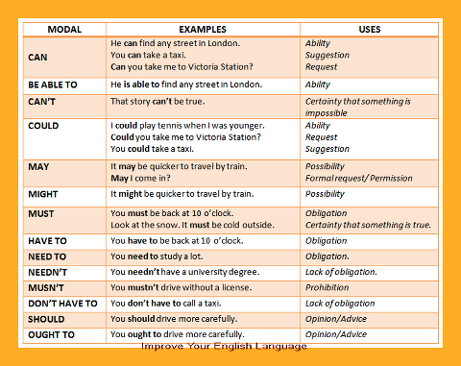

Slide 10
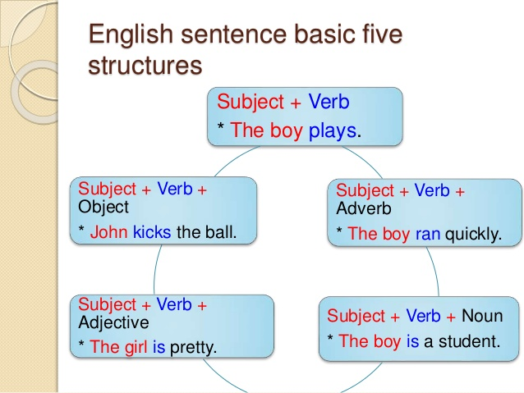

Slide 11
Writing instructions
Instructions are usually written in imperatives
Imperative sentences
Pour me a glass of water.
Leave the package at the door.
Take me to the library.
Walk through this door and turn left at the next hallway.
Come over here, look at this specimen, and tell me what you think.
Put that down now!
Tell the truth, the whole truth and nothing but the truth.

Slide 12
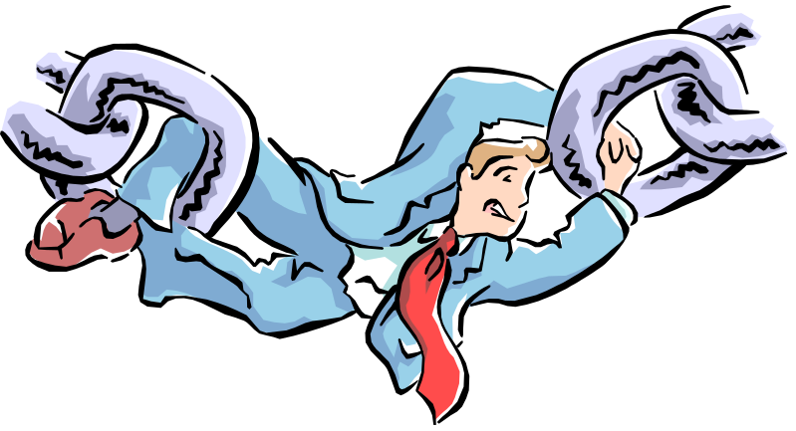
Adding Connectives:
These are used when you want to add ideas together that agree with each other or are about the same thing.
and
also
as well as
moreover
too
No: I like cheese. I like sausages.
Yes: I like cheese, I also like sausages.

Slide 13

Sequencing Connectives
next
then
first, second, third…
finally
meanwhile
eventually
after
before
These are used when you want to list ideas in a certain order.
No: I cut the cheese. I cooked sausages.
Yes: I cut cheese, finally I cooked the sausages.

Slide 14

Emphasising Connectives
above all
in particular
especially
significantly
indeed
notably
These are used when you want to stress a point as being very important.
No: I like cheese. I really like cheddar.
Yes: I like cheese, in particular, cheddar.

Slide 15

Comparing Connectives
equally
in the same way
similarly
likewise
as with
like
These are used when you want to compare ideas that are similar or the same as each other.
No: I like cheese. I like sausages.
Yes: I like cheese, equally I like sausages.

Slide 16

Cause and Effect Connectives
because
so
therefore
thus
consequently
These are used when you want the second part of your sentence to help explain the first part. The second part happens as a result of the first.
No: I like cheese. I ate the cheese.
Yes: I like cheese, therefore I ate the cheese!

Slide 17
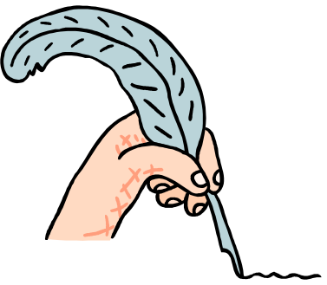
Qualifying Connectives
however
although
except
if
as long as
These are used when the first idea in your sentence relies on the second part happening.
No: I’ll cut the cheese. You get the knife.
Yes: I’ll cut cheese, as long as you get the knife.

Slide 18

Illustrating Connectives
for example
such as
for instance
as revealed by
in the case of
These are used when you want to give an example to back up the first part of your sentence.
No: I like cheese. I like cheddar and Red Leicester.
Yes: I like cheese, such as Cheddar and Red Leicester!

Slide 19

Contrasting Connectives
whereas
instead of
alternatively
otherwise
unlike
on the other hand
These are used when you have two ideas in your sentence that do not agree with each other.
No: I like cheese. I do not like tomatoes.
Yes: I like cheese, on the other hand, I do not like tomatoes.

